Slide 1
Gradient Boosting and Ensemble technique in Machine Learning

Slide 2
Ensemble technique:
Ensemble technique is a technique which uses multiple weak
learners to produce a strong model for regression and classification.
In ensemble learning, many base models like classifiers and
regressors are generated and combined together so that they give
better results.

Slide 3
Types of ensemble technique:
The three most popular methods for combing the predictions
from different models are:
bagging
Boosting
voting
Bagging: Building multiple models (typically of the same type)
from different subsamples of the training dataset .

Slide 4
Boosting: Building multiple models (typically of the same type)
each of which learns to fix the prediction errors of a prior
model in the sequence of models.
Voting: Building multiple models (typically of the Differing
types) and simple statistics (like calculating the Mean) are
used to combine predictions.

Slide 5
Gradient Boosting:
Gradient Boosting is an supervised machine learning algorithm
used for classification and regression problems. Gradient Boosting
is a popular boosting algorithm.
In gradient boosting, each predictor corrects its predecessor’s error.
It is an ensemble technique which uses multiple weak learners to
produce a strong model for regression and classification.
Here each predictor is trained using the residual errors of
predecessor as labels.

Slide 6
steps of gradient boosting :
Calculate the average/mean of the target variable.
2. calculate the residuals for each sample. Residual = Actual Value
- Predicted Value

Slide 7
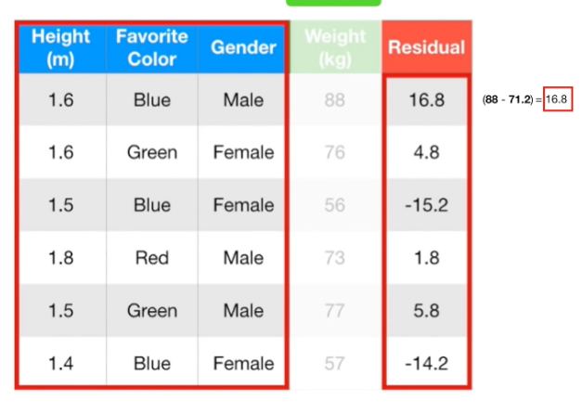

Slide 8
3. use decision tree algorithm to train the model considering
residual as label .We build a tree with the goal of predicting the
Residuals.
4. Repeat steps 3 to 5 until the number of iterations matches the
number specified by the hyper parameter(numbers of estimators)

Slide 9
5. Once trained, use all of the trees in the ensemble to make a final
prediction as to value of the target variable.
The final prediction will be equal to the mean we computed in Step 1
plus all the residuals predicted by the trees that make up the forest multiplied
by the learning rate.
final prediction = Average Price + LR*Residual predicted by DT1 + LR*Residual
Predicted by DT2 + .......LR*Residual Predicted by DT N
Here,
LR = Learning rate
DT = Decision tree

Slide 10
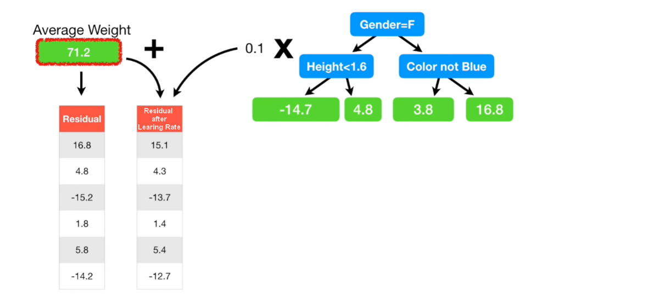

Slide 11
Thank you

